Slide 1
Topic: Fractions
EQ: How do I add and subtract fractions with diagrams?

Slide 2
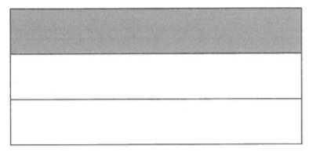

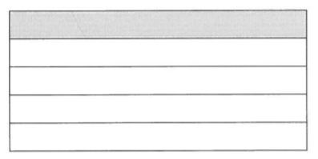
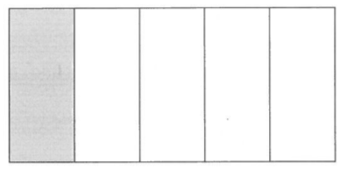
How can you fold the A4 paper to make $\frac{1}{3}$
or
How can you fold the A4 paper to make $\frac{1}{5}$
or

Slide 3
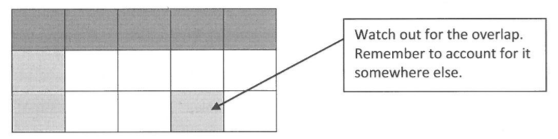
Is there a way that they can put the third and fifth together on the same cake?

Slide 4
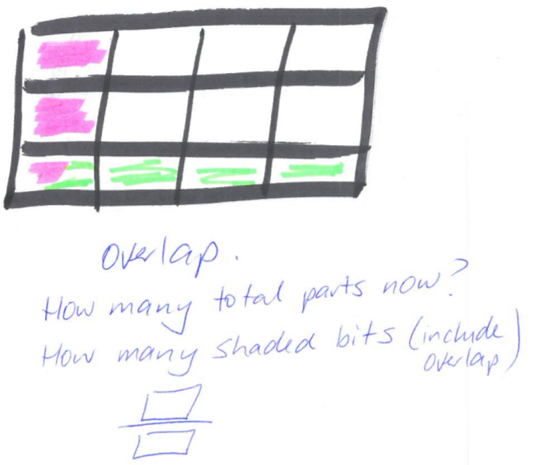
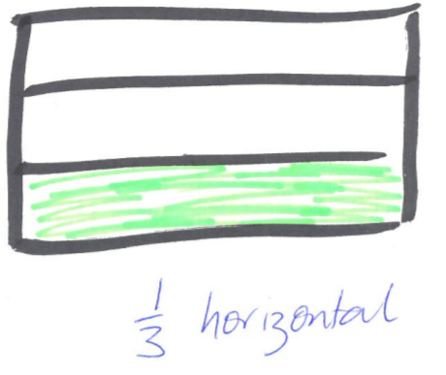
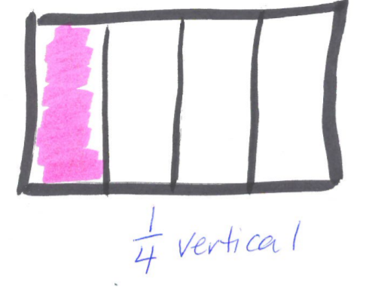
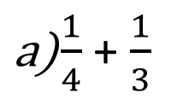
$\frac{1}{4}$ + $\frac{1}{3}$

Slide 5

Use the same process to add the following fractions:
$\frac{2}{5}$ + $\frac{1}{3}$
b) $\frac{1}{5}$ + $\frac{1}{4}$
c) $\frac{2}{3}$ + $\frac{1}{4}$
d) $\frac{2}{3}$ + $\frac{1}{2}$

Slide 6
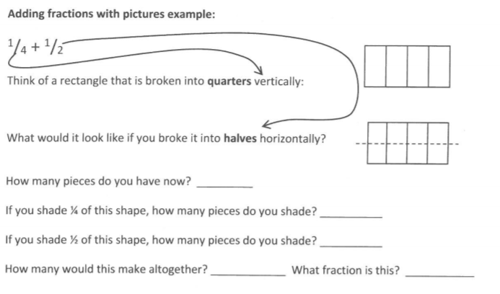

Slide 7
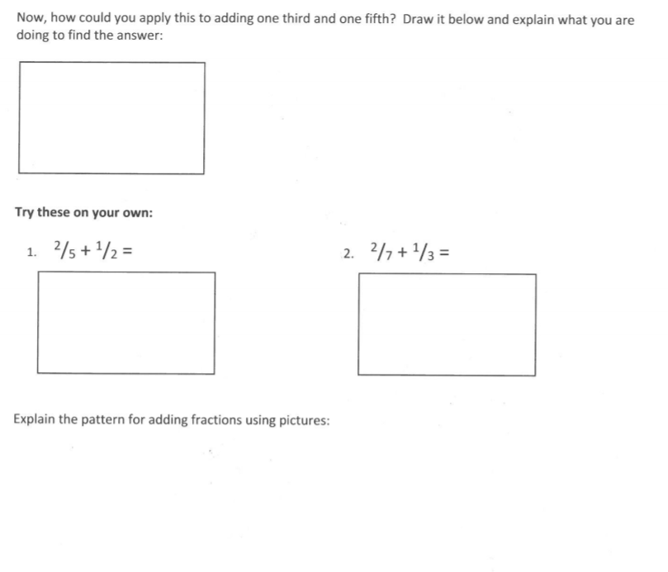

Slide 8
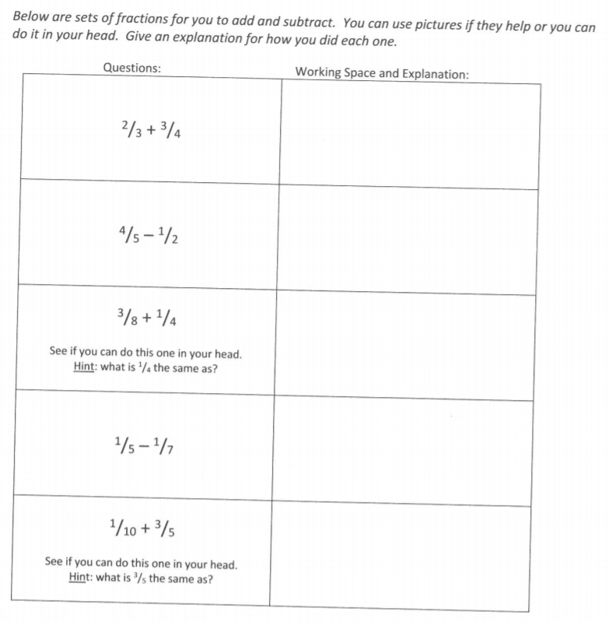

Slide 9
Fractions
New EQ and topic
EQ: What happens when you add fractions with the same denominator?

Slide 10

24
7
30
Fractions
Date
EQ: What happens when you add fractions with the same denominator?
Method 2
Adding With Same Denominator
$$\frac{1}{7}+\frac{4}{7}$$

Slide 11
24
7
30
Fractions
Date
EQ: What happens when you add fractions with the same denominator?
Method 2
Adding With Same Denominator
$$\frac{1}{7}+\frac{4}{7}$$

Slide 12
24
7
30
Fractions
Date
EQ: What happens when you add fractions with the same denominator?
Method 2
Adding With Same Denominator
$$\frac{1}{7}+\frac{4}{7}$$

Slide 13

24
7
30
Fractions
Date
EQ: What happens when you add fractions with the same denominator?
Method 2
Adding With Same Denominator
$$\frac{1}{7}+\frac{4}{7}=\frac{5}{7}$$

Slide 14
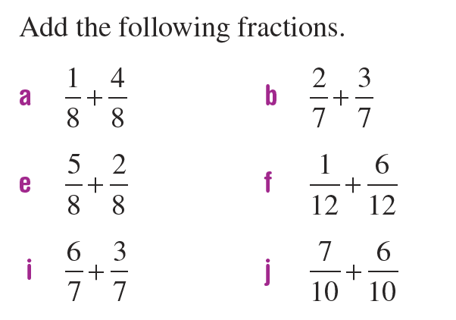
Practice

Slide 15
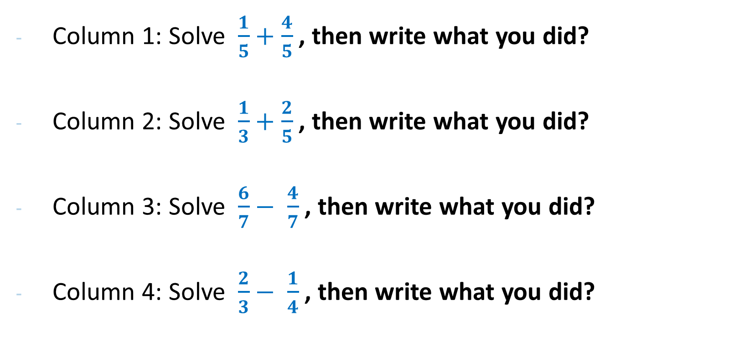
Divide your page in quarters
Column 1: Solve $\frac{1}{5}+\frac{4}{5}$ , then write what you did?
Column 2: Solve $\frac{1}{3}+\frac{2}{5}$ , then write what you did?
Column 3: Solve $\frac{6}{7}− \frac{4}{7}$ , then write what you did?
Column 4: Solve $\frac{2}{3}− \frac{1}{4}$ , then write what you did?

